Slide 1


Slide 2

NADRA ADMINISTRATION SYSTEM
SEMESTER PROJECT
GROUP MEMBERS:
SHARJEEL
MARIA MUSHTAQ
Notes:
NOTE:
To change the image on this slide, select the picture and delete it. Then click the Pictures icon in the placeholder to insert your own image.

Slide 3
Content
INTRODUCTION
RELATIONAL SCHEMA
DATA ENTRY
DATA REDUNDENCY AND DEPENDENCIES
DATA NORMALIZATION
FRONT-END WEBSITE
HOME PAGE
REGISTRATION FORM
MARRIAGE CERTIFICATION AND REGISTRATION FORM
RECORD FORM
CHILD REGISTRATION FORM
ID RENEWAL FORM
MY CONNECTION TO WEBSITE
ERD
CONCLUSION

Slide 4
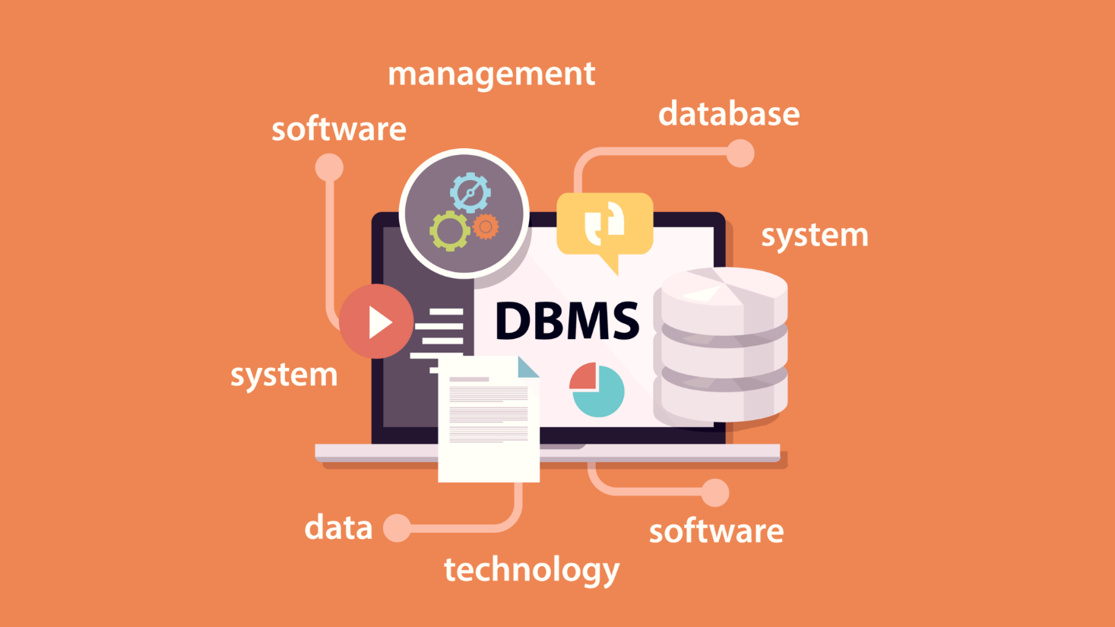
INTRODUCTION
To establish a website of NADRA ADMINSITRATION SYSTEM using our knowledge and basis of DBMS to provide an online solution for identification, securing documents and facilitating the public.
It may also deliver the purpose of mitigating identity theft and safe-guarding the interests of people.
Now the Government of Pakistan is trying to shift all the existing record of National Identity card(NIC) using central computerized database.

Slide 5
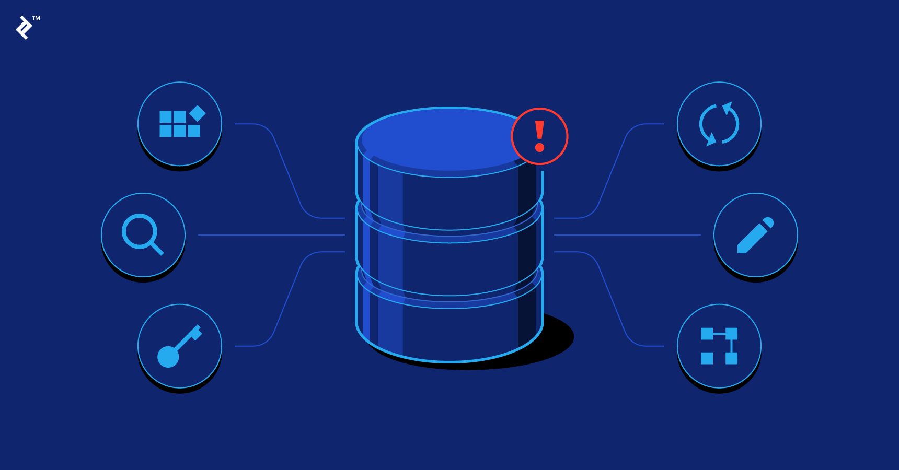
DATABASE

Slide 6
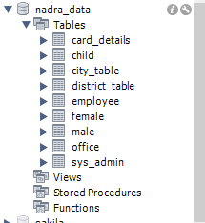
RELATIONAL SCHEMA
Our database is named as nadra_data.
The following relational schemas are made:
card_details
Child
City_table
District_table
Employee
Female
Male
Office
Sys_admin

Slide 7
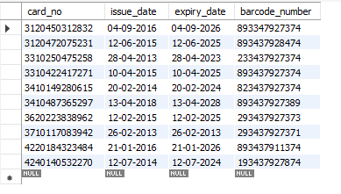
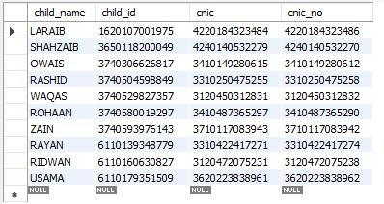
DATA ENTRY
card_details child

Slide 8
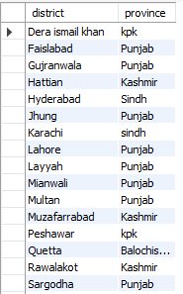
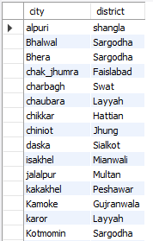
DATA ENTRY
city_table district_table

Slide 9
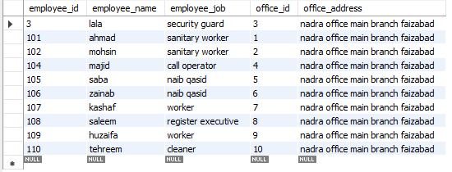
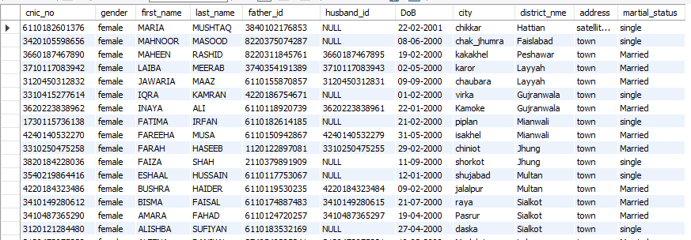
DATA ENTRY
employee
female

Slide 10
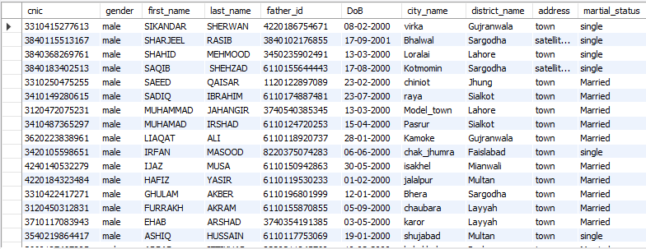
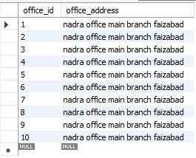
DATA ENTRY
male
office

Slide 11
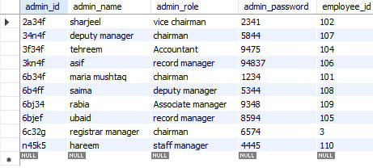
DATA ENTRY
sys_admin

Slide 12
DATA REDUNDENCY AND DEPENDENCIES
We applied normalization to our tables to reduce data redundancy and different types of dependencies.
Male and Female tables contain attributes city, district and province.
District was dependent on city and province was dependent on district.
The attributes also had redundant data
Employee table had attributes office_id and office_address
Office_address was dependent on office_id

Slide 13
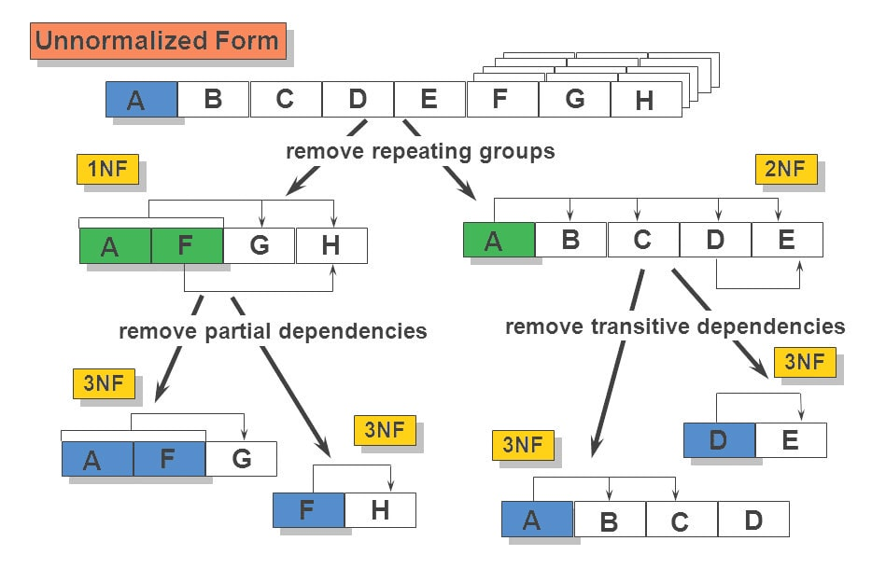
DATA NORMALIZATION
Data normalization is the organization of data to appear similar across all records and fields. It increases the cohesion of entry types leading to cleansing, lead generation, segmentation, and higher quality data

Slide 14
Continued…
To remove any redundancy, we added three new tables
City_table
District_table
Office
This resulted in removal of functional and partial dependencies, adding more practical approach to add someone in the database.

Slide 15
Male Table
Cnic | First_name | Last_name | Father_id | DoB | Address | City | District | Province | Marital_status
female Table
Cnic_no | First_name | Last_name | Father_id | Husband_id | DoB | Adress | City | District | Province | Marital_status
Employee Table
Employee_id | Employee_name | Employee_job | Office_id | Office_address

Slide 16
City Table
Office Table
City | District | Province
Office_id | Office_address
City Table
District Table
City | District
District | Province

Slide 17

FRONT-END WBSITE

Slide 18
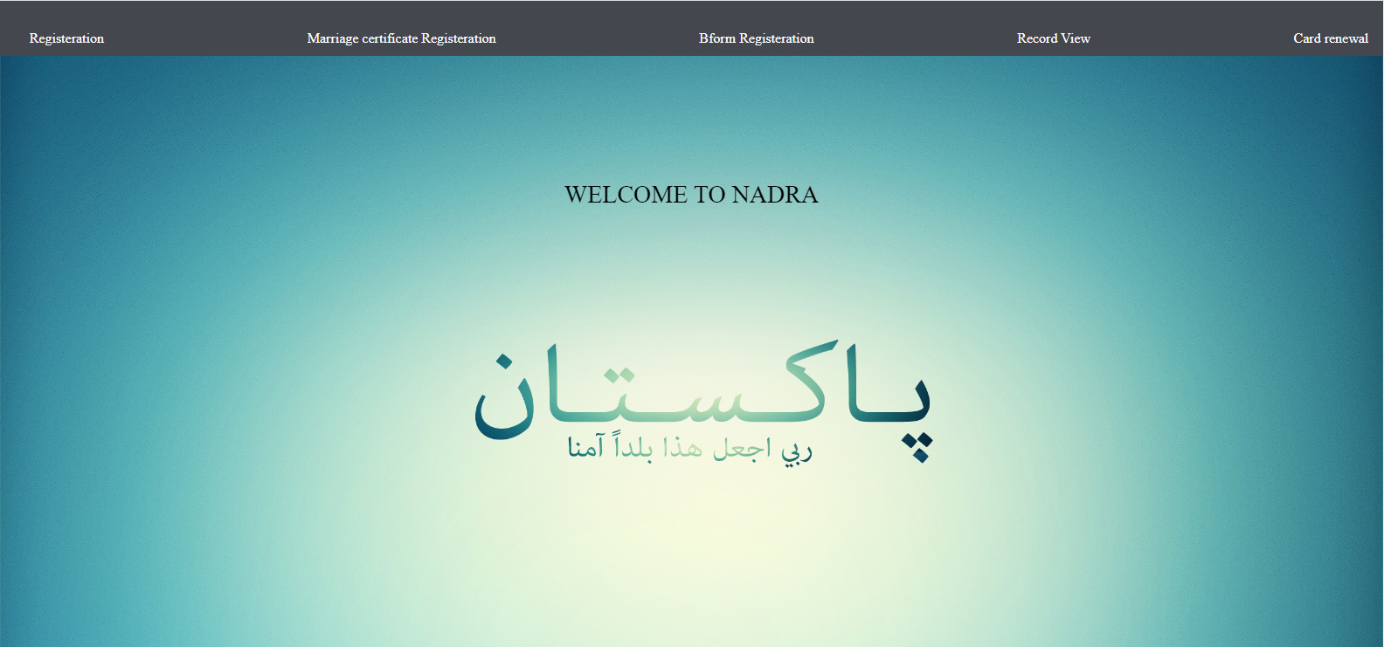
HOME PAGE

Slide 19
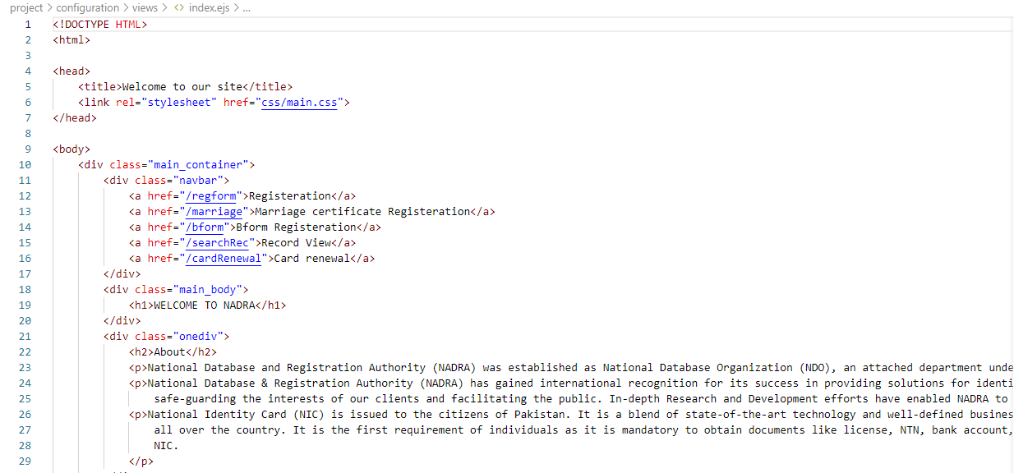
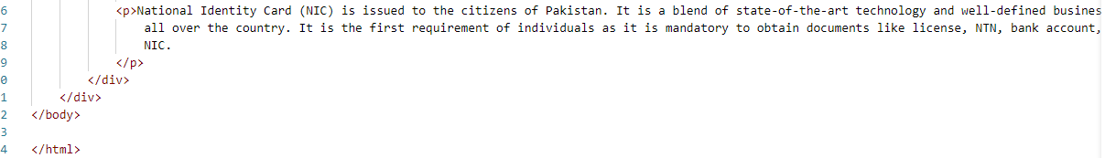

Slide 20
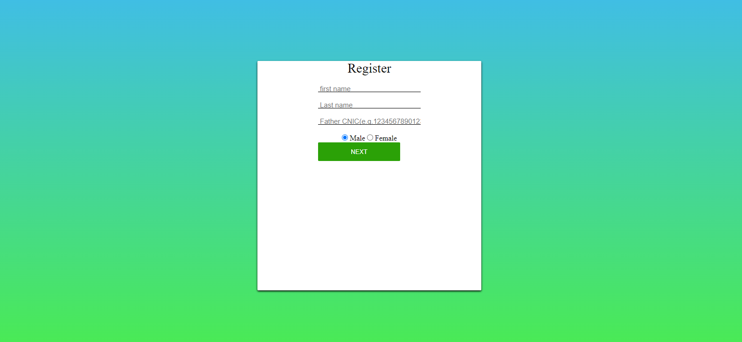
REGISTRATION FORM

Slide 21
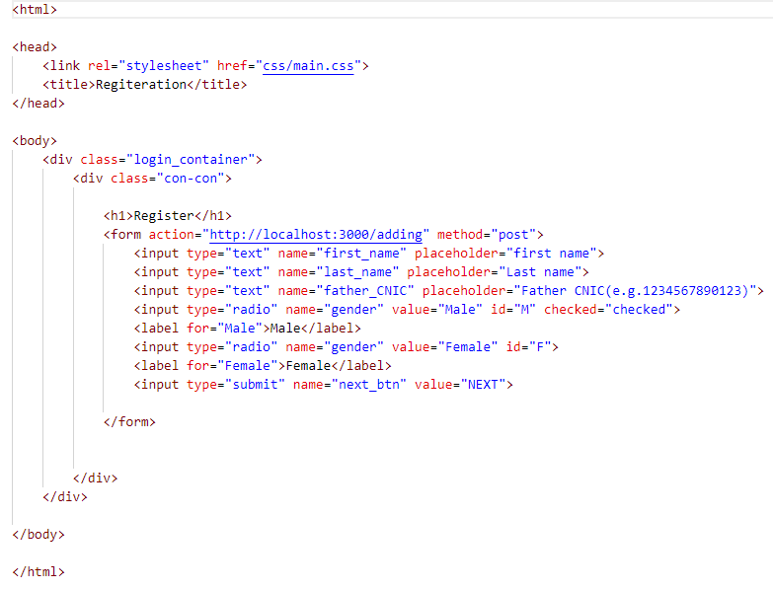

Slide 22
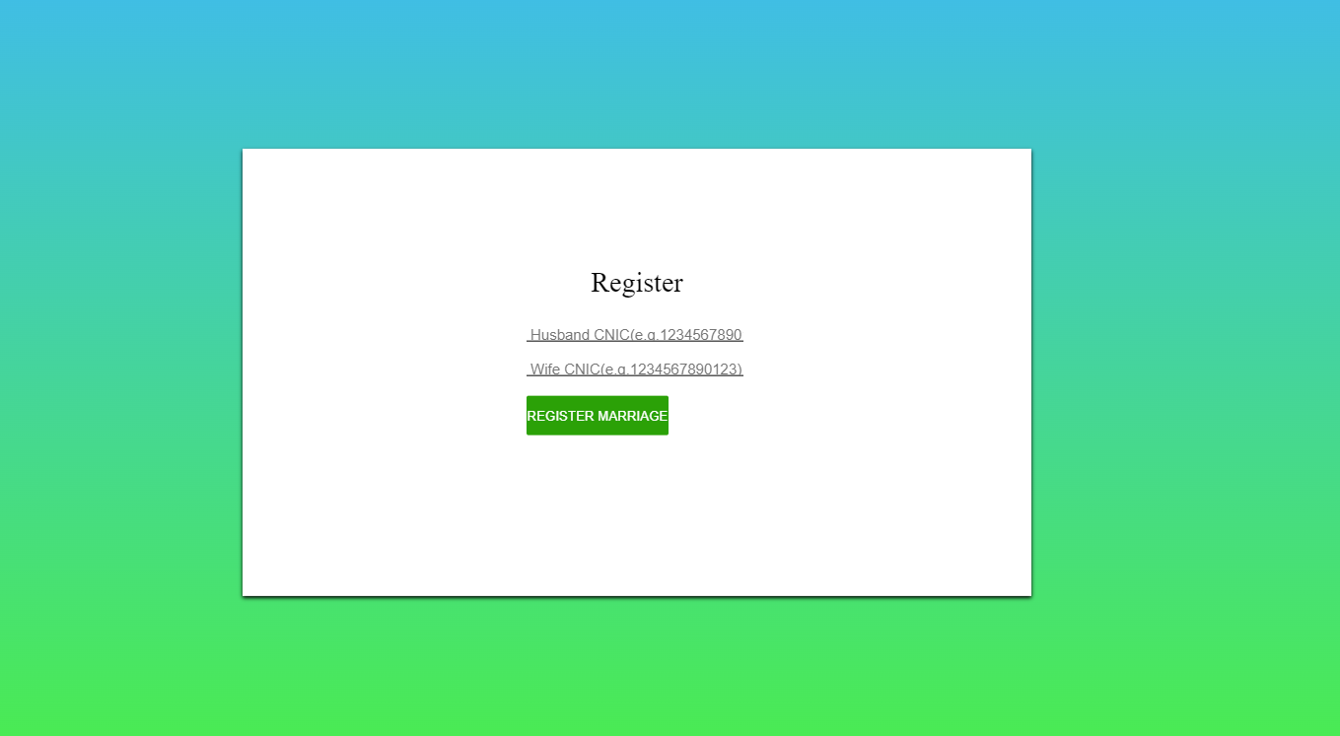
MARRIAGE CERTIFICATE & REGISTRATION FORM

Slide 23
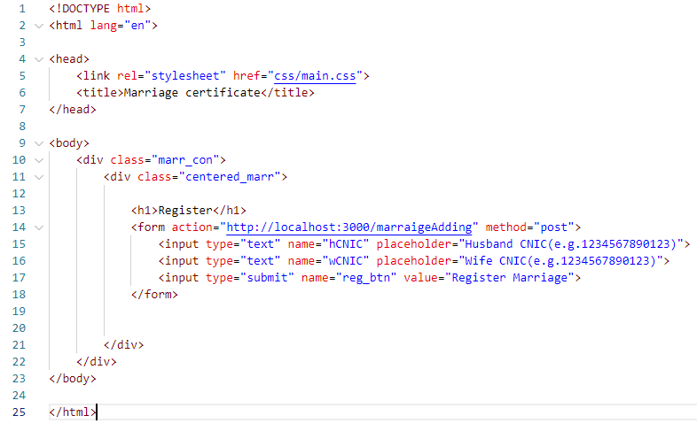

Slide 24
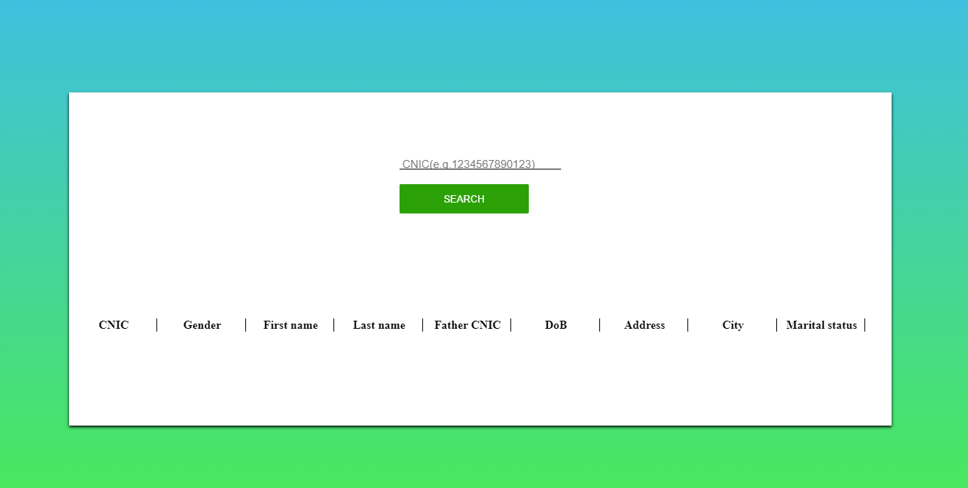
RECORD FORM

Slide 25
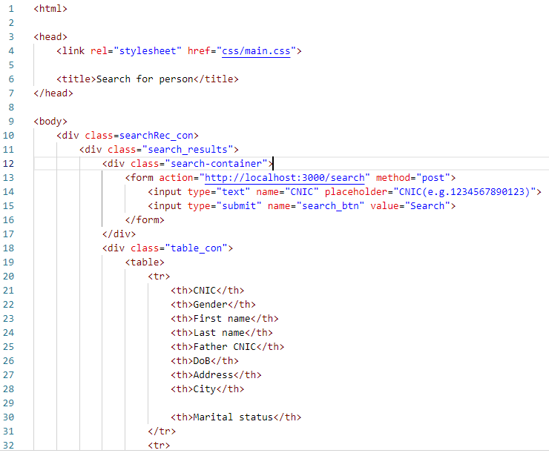
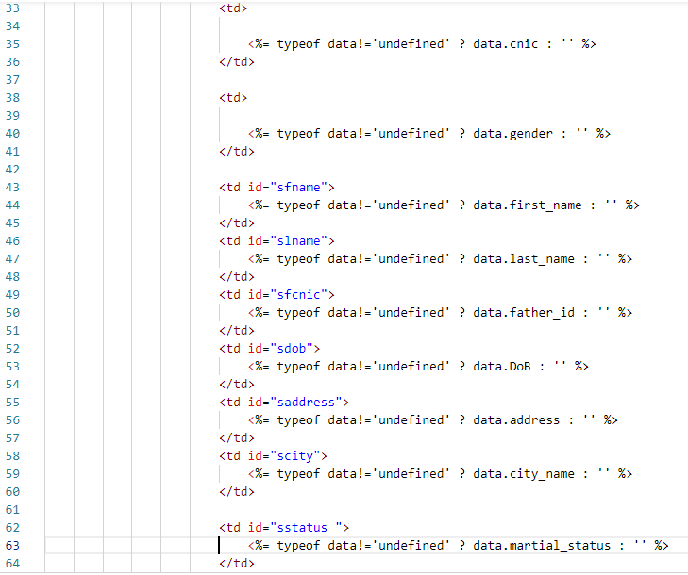

Slide 26
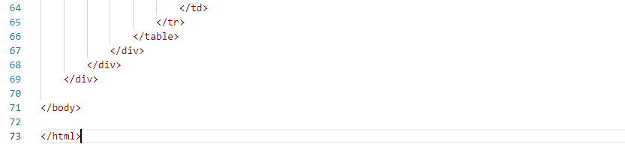

Slide 27

CHILD REGISTRATION FORM

Slide 28
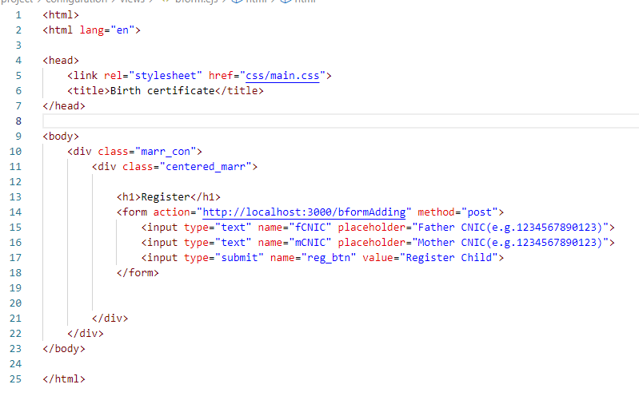

Slide 29
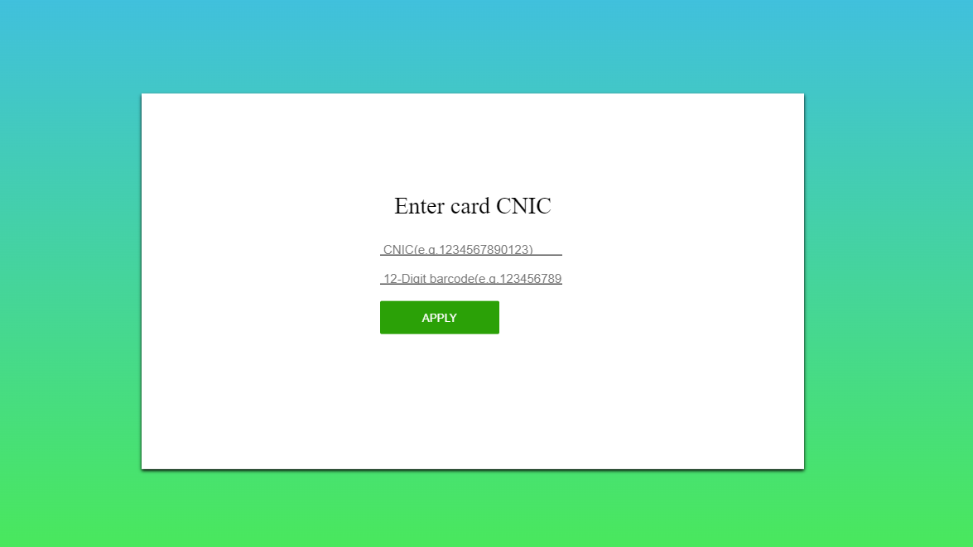
ID RENEWAL FORM

Slide 30
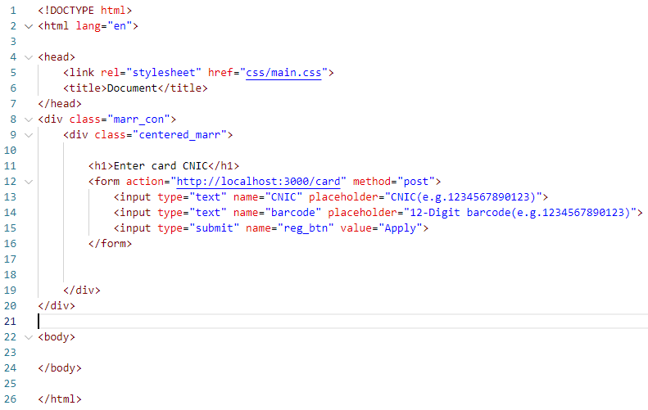

Slide 31

MYsql CONNECTION TO WEBSITE

Slide 32
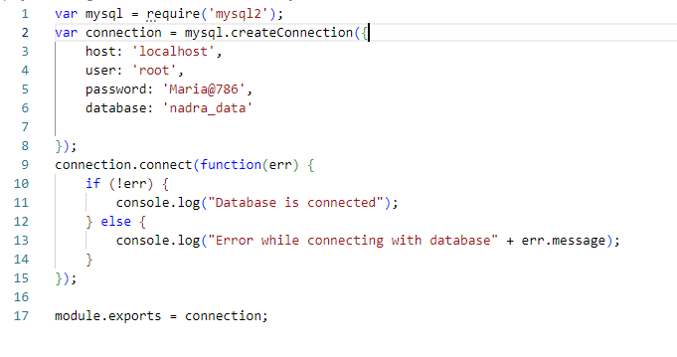
CONNECTION TO WEBSITE

Slide 33
ERD
ER Diagram is a visual representation of data that describes how data is related to each other using different ERD Symbols and Notations.
An entity–relationship model (or ER model) describes interrelated things of interest in a specific domain of knowledge. A basic ER model is composed of entity types (which classify the things of interest) and specifies relationships that can exist between entities (instances of those entity types).

Slide 34
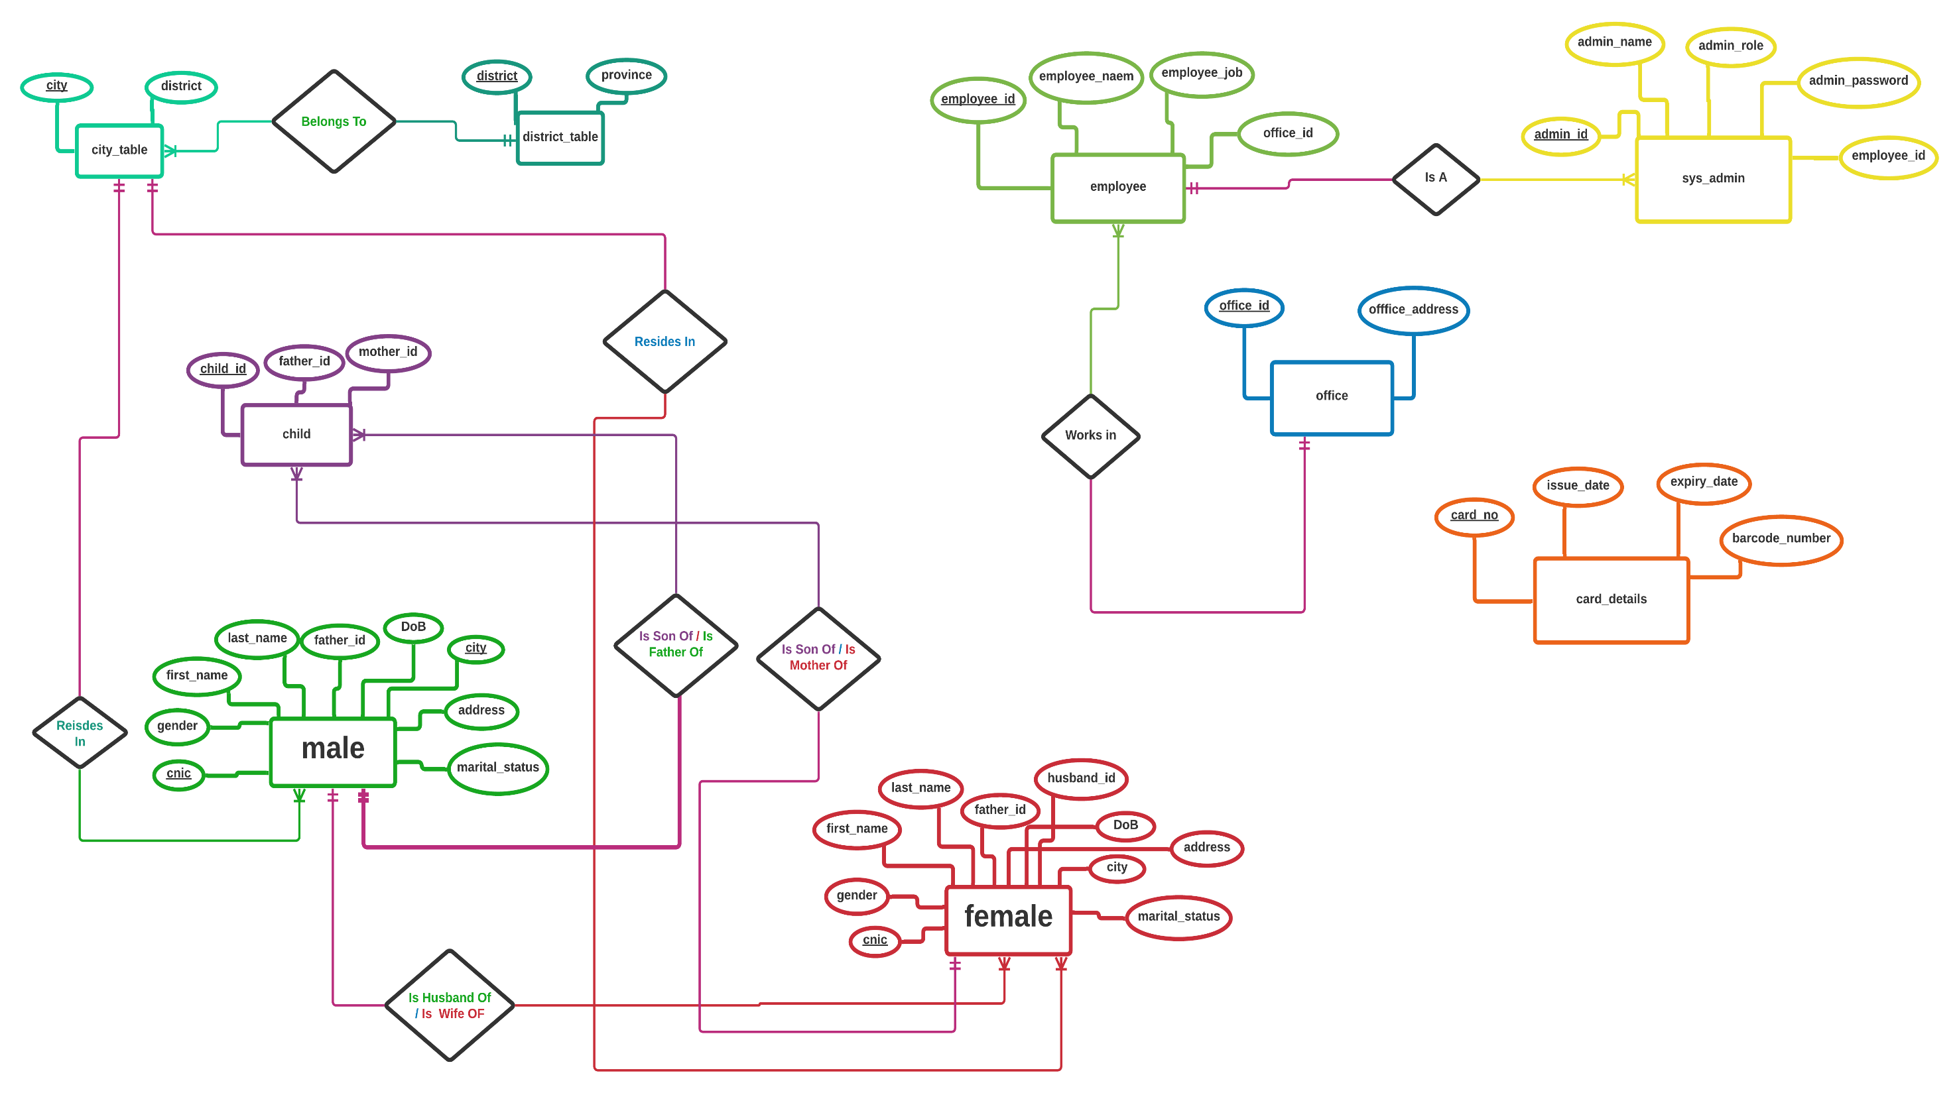

Slide 35
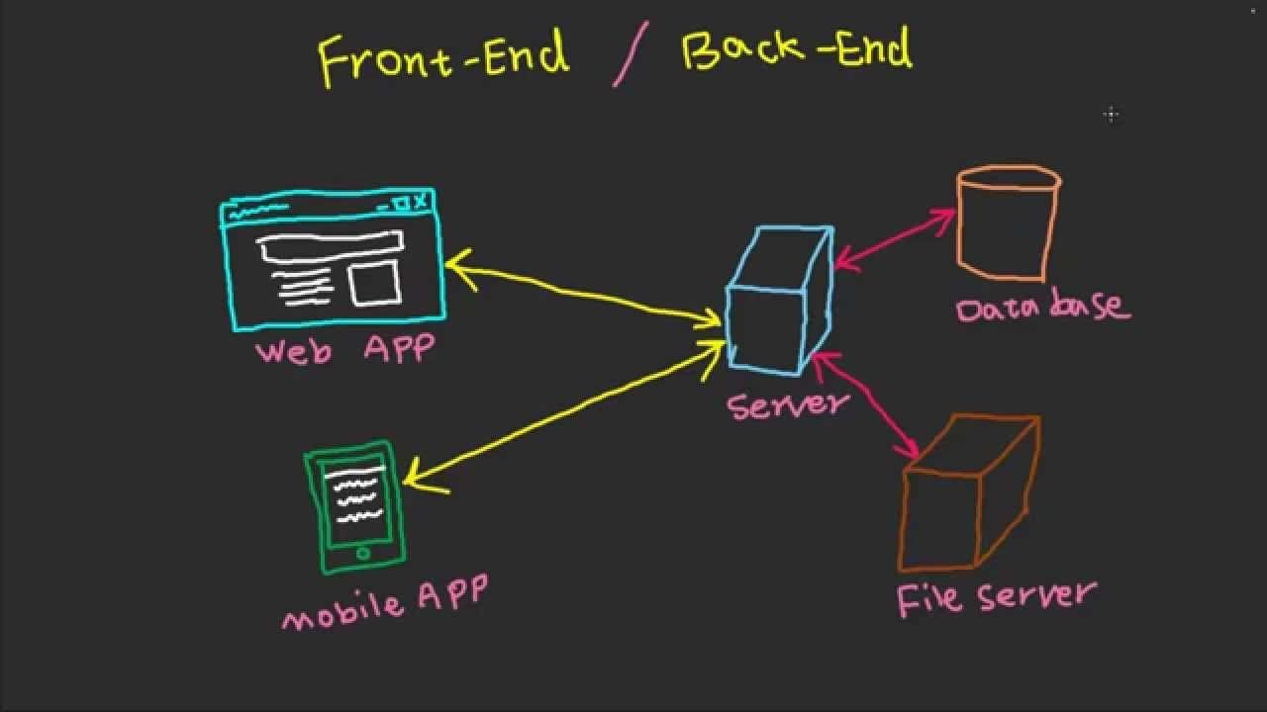
CONCLUSION
we conclude the whole work, we simply made a basic relational database that shows the relationship among different entities and then made a basic front end page of NADRA that consists of different views and show a connection among the front-end and database which was the requirement of this project.

Slide 36

THANK YOU!!

